Slide 1
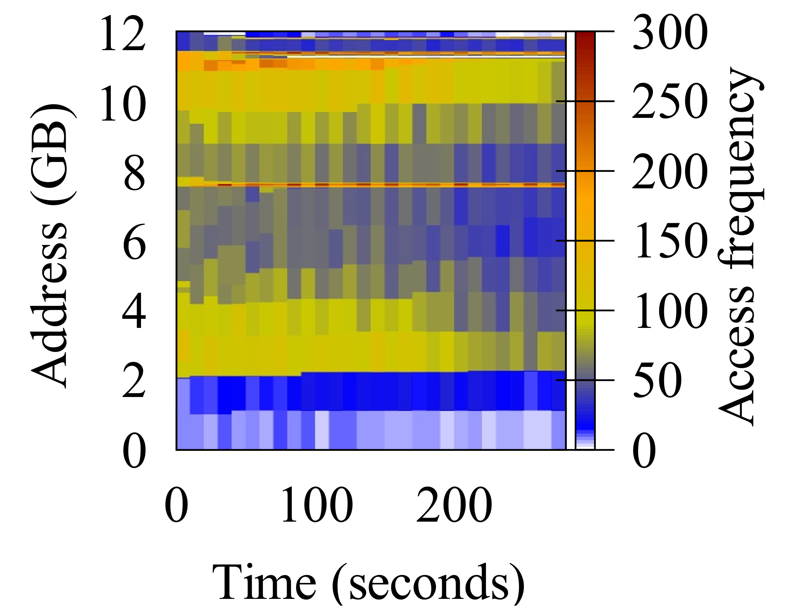
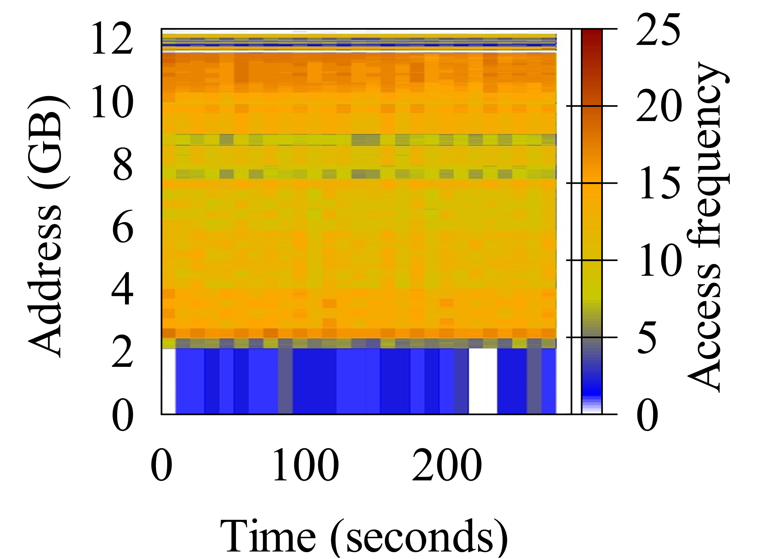
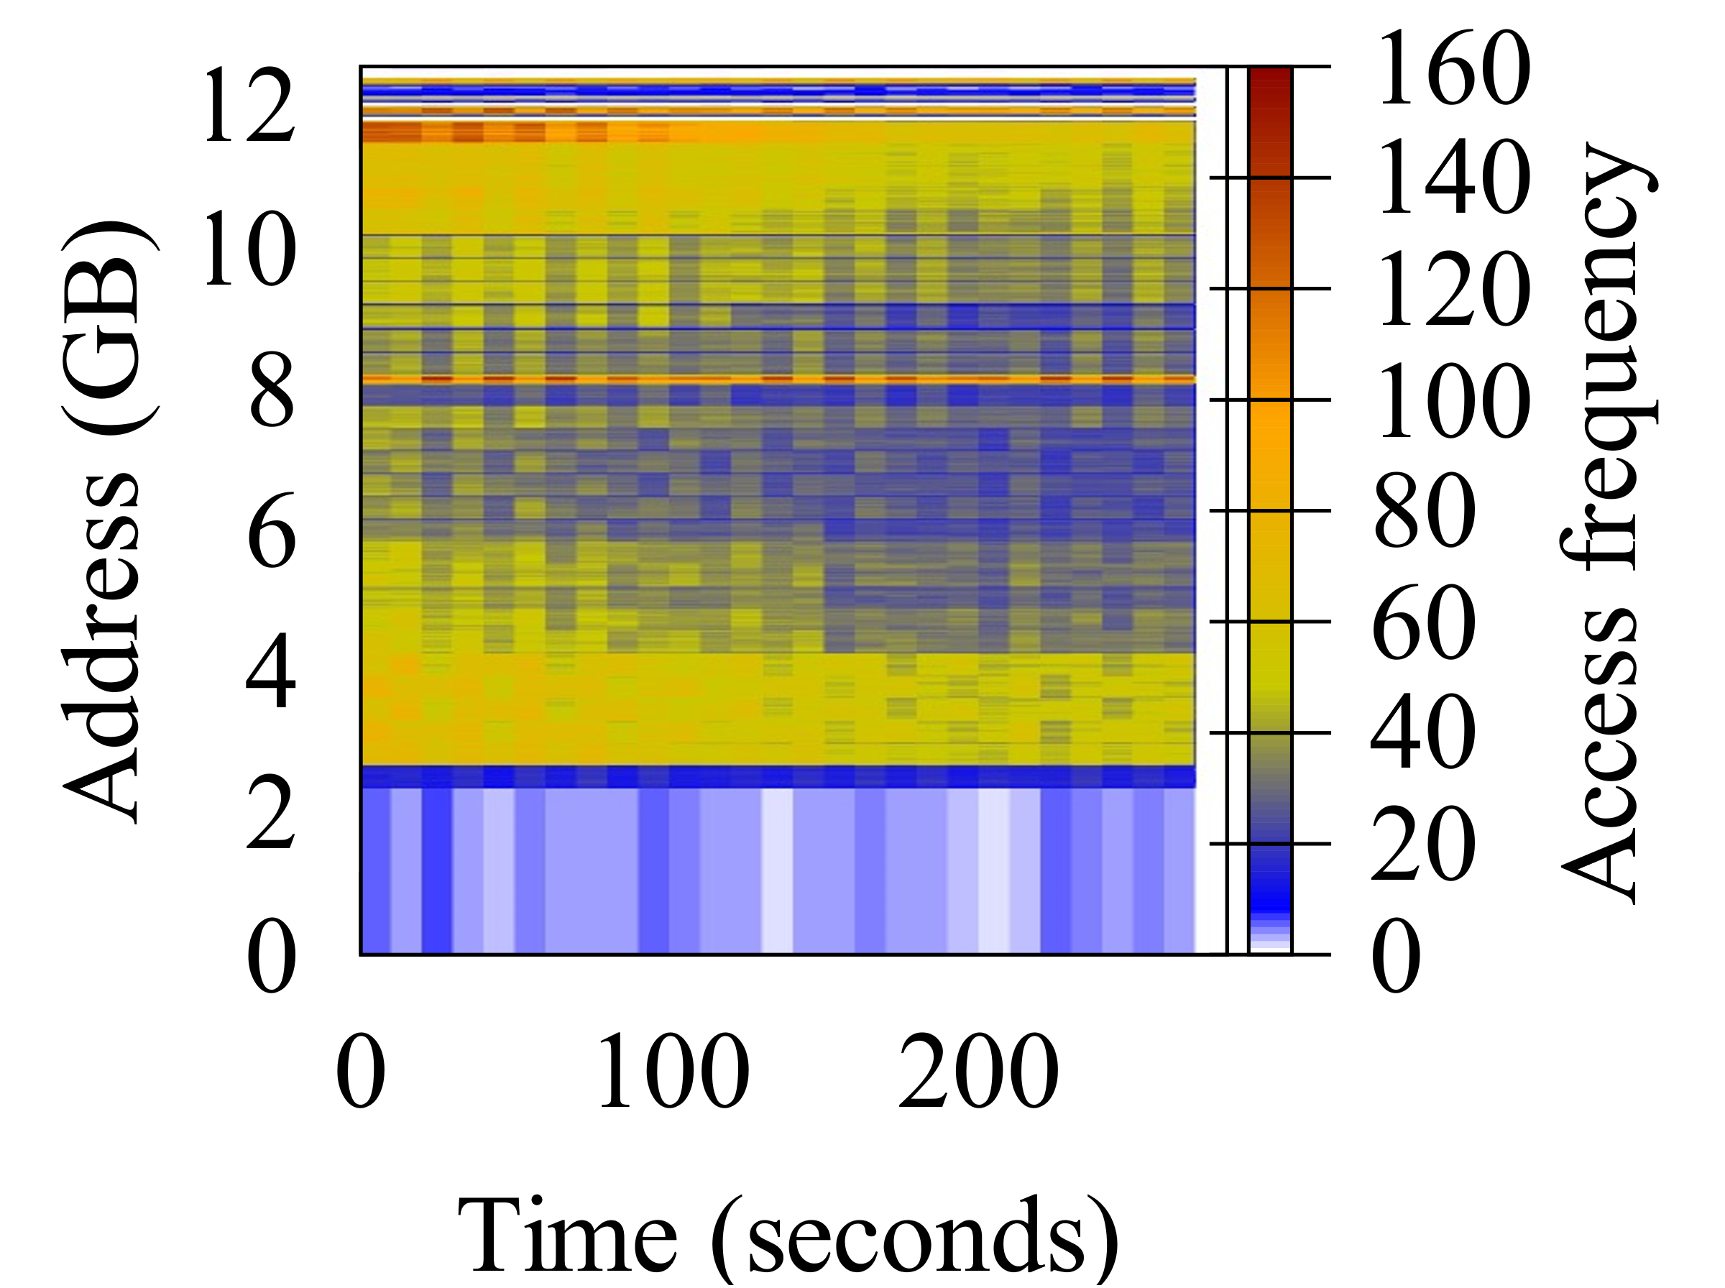
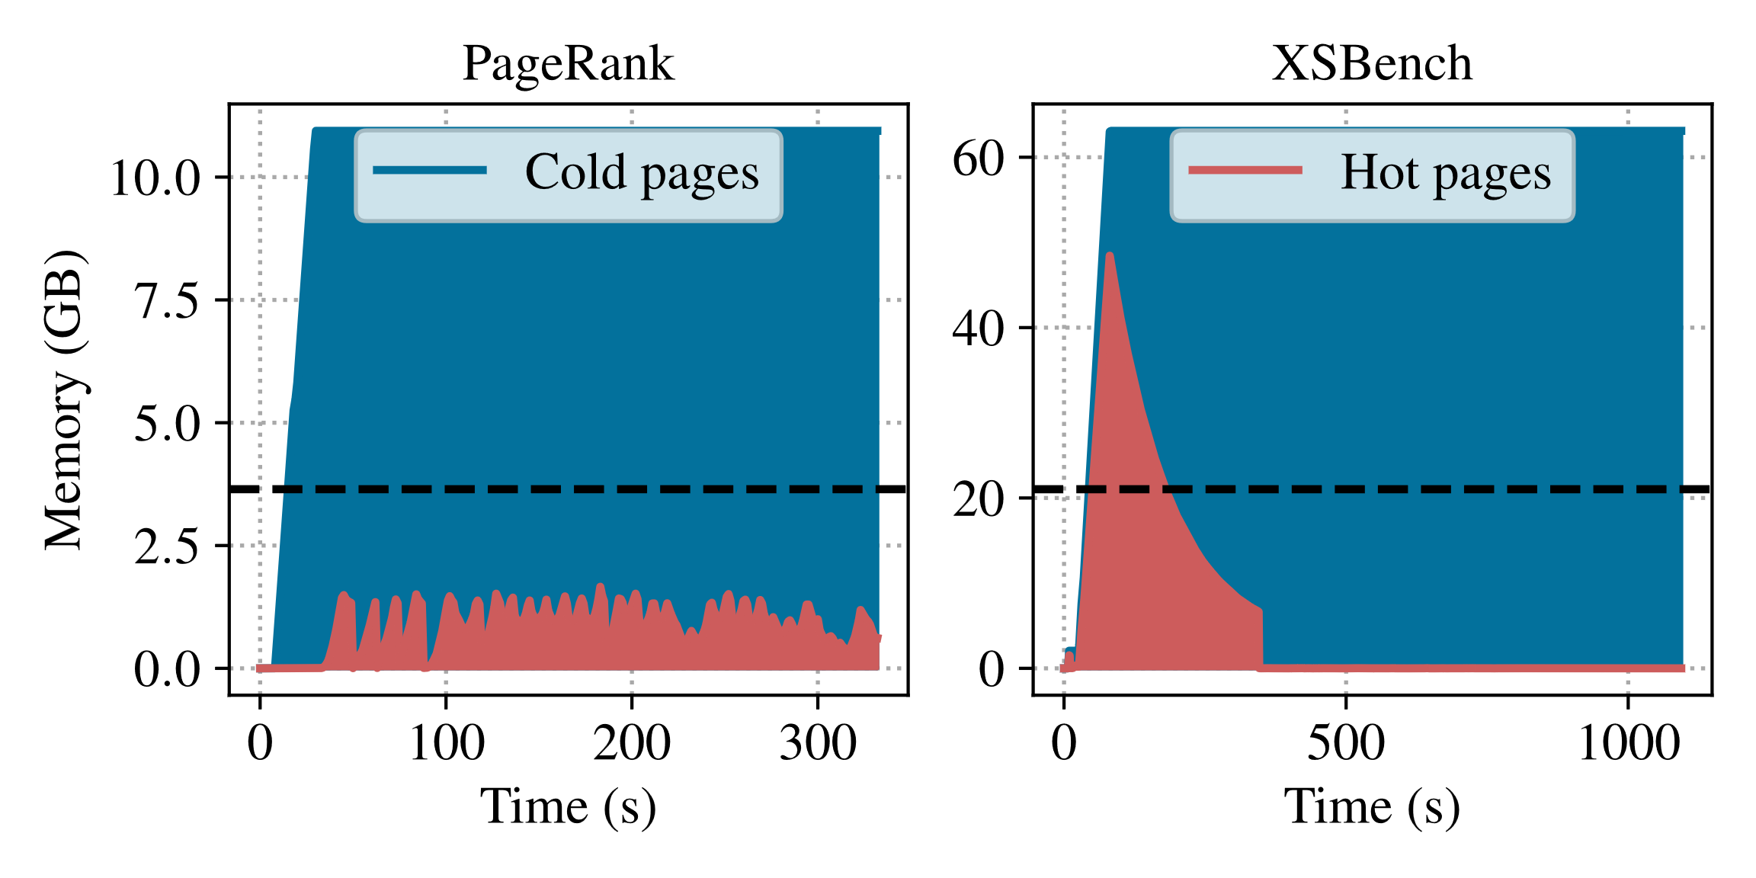
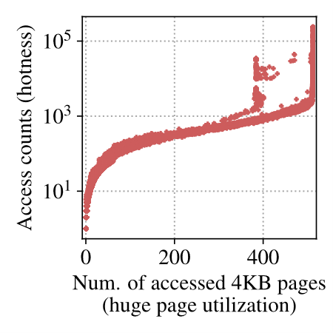
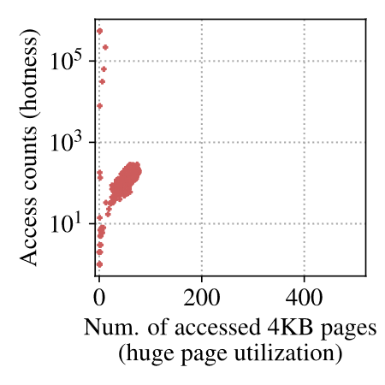
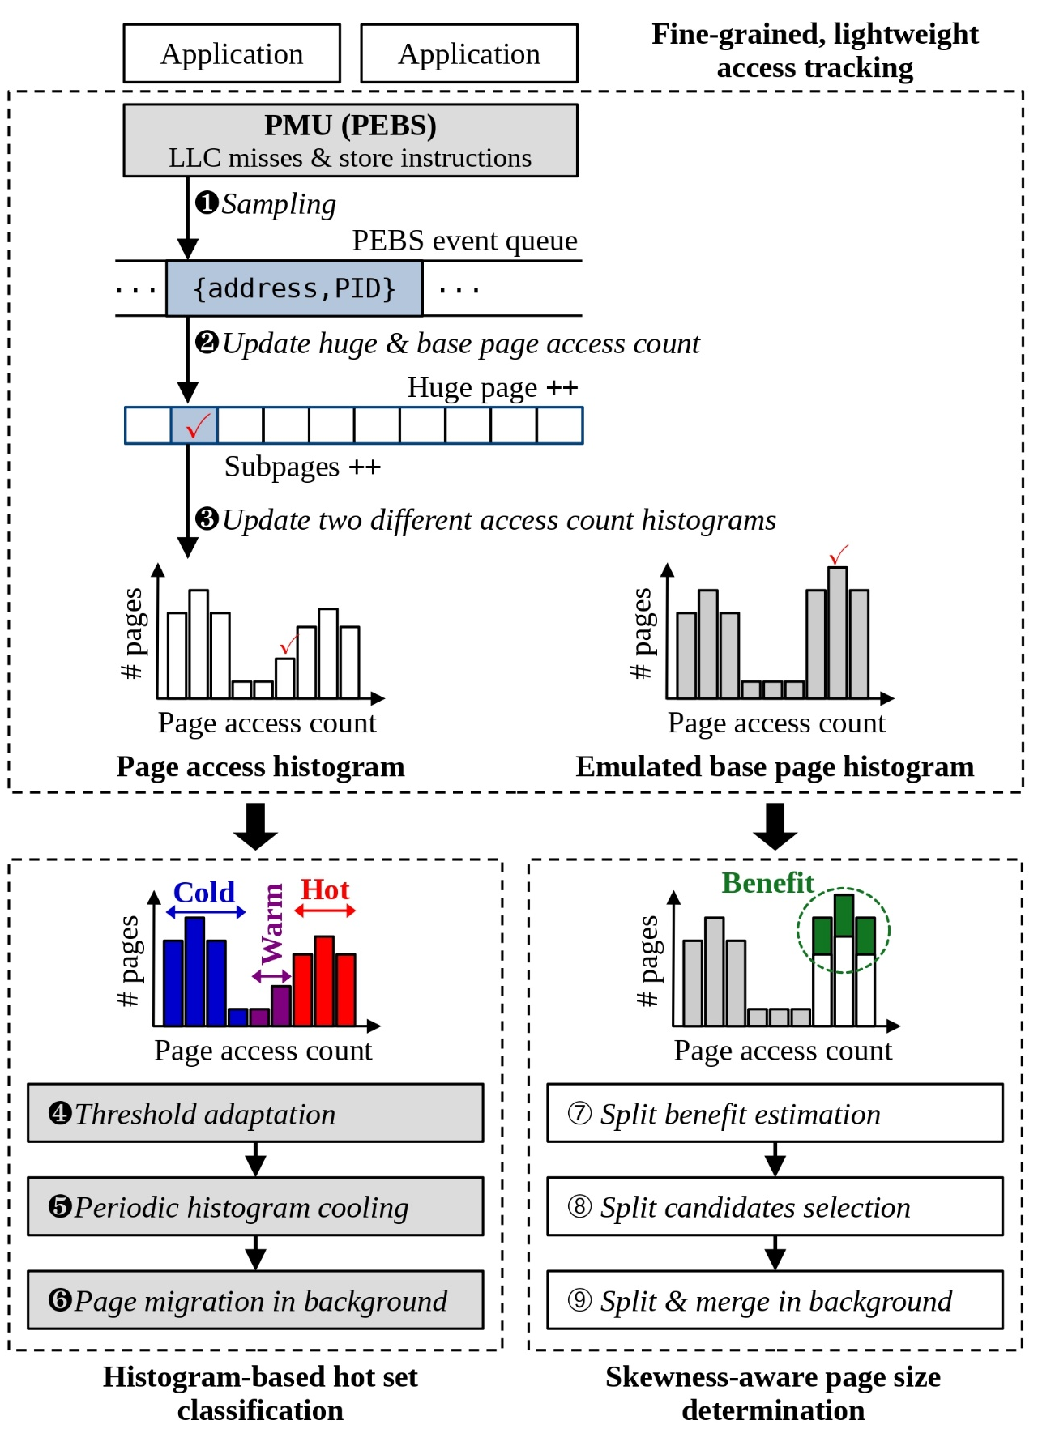
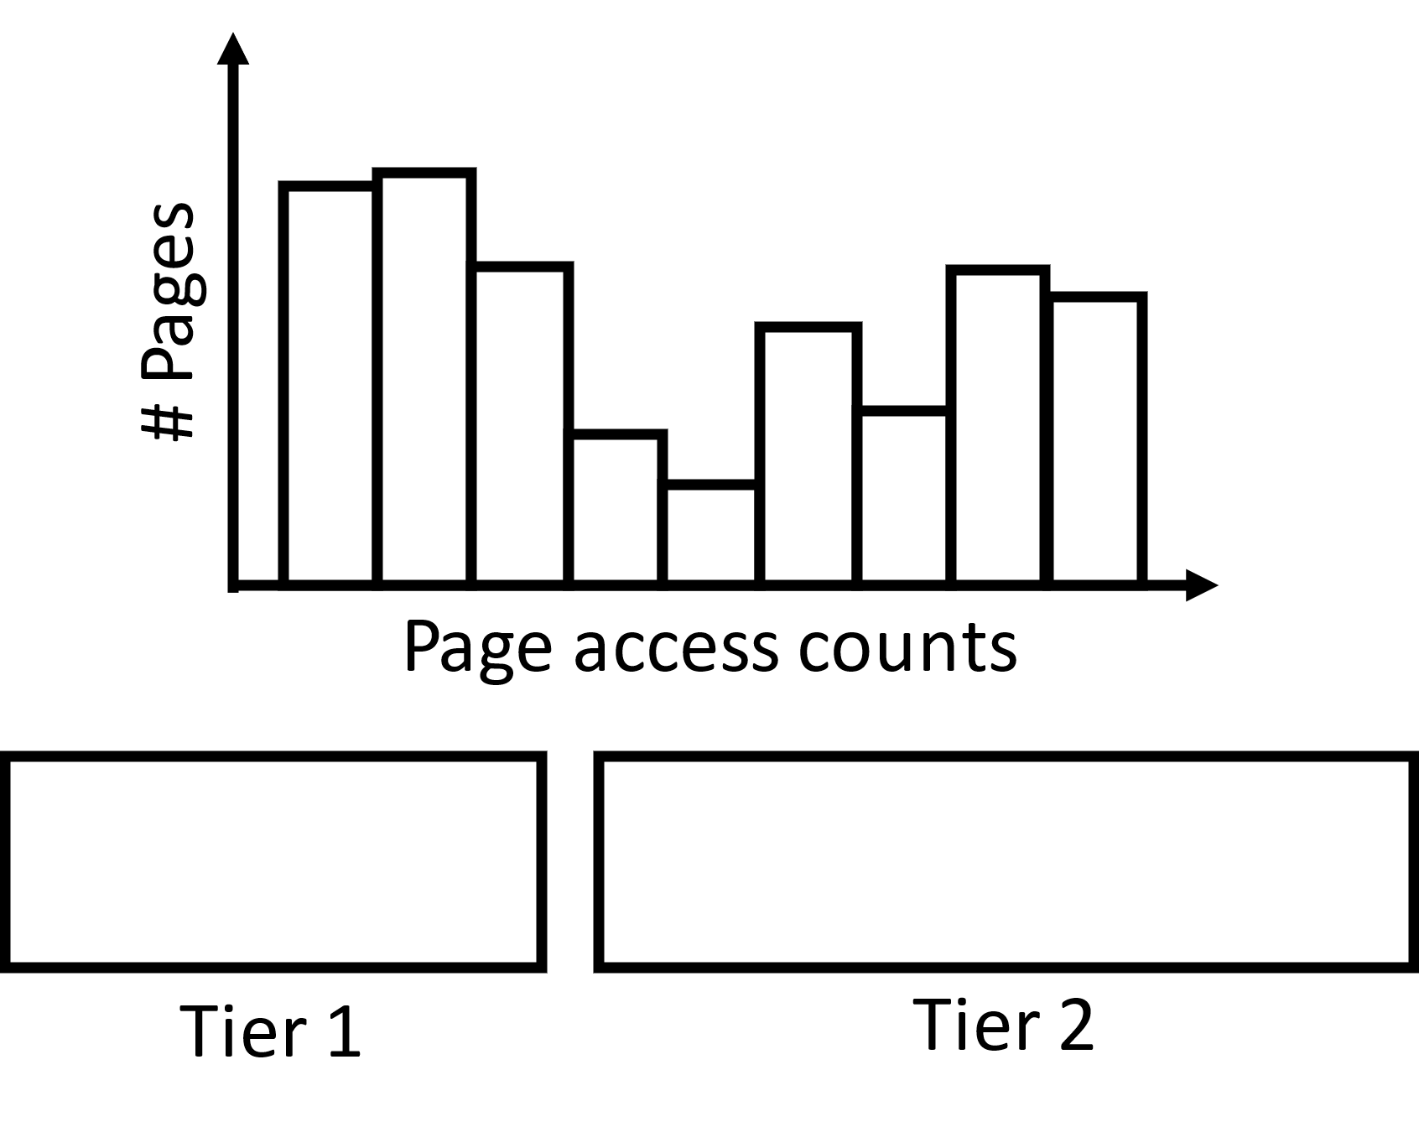
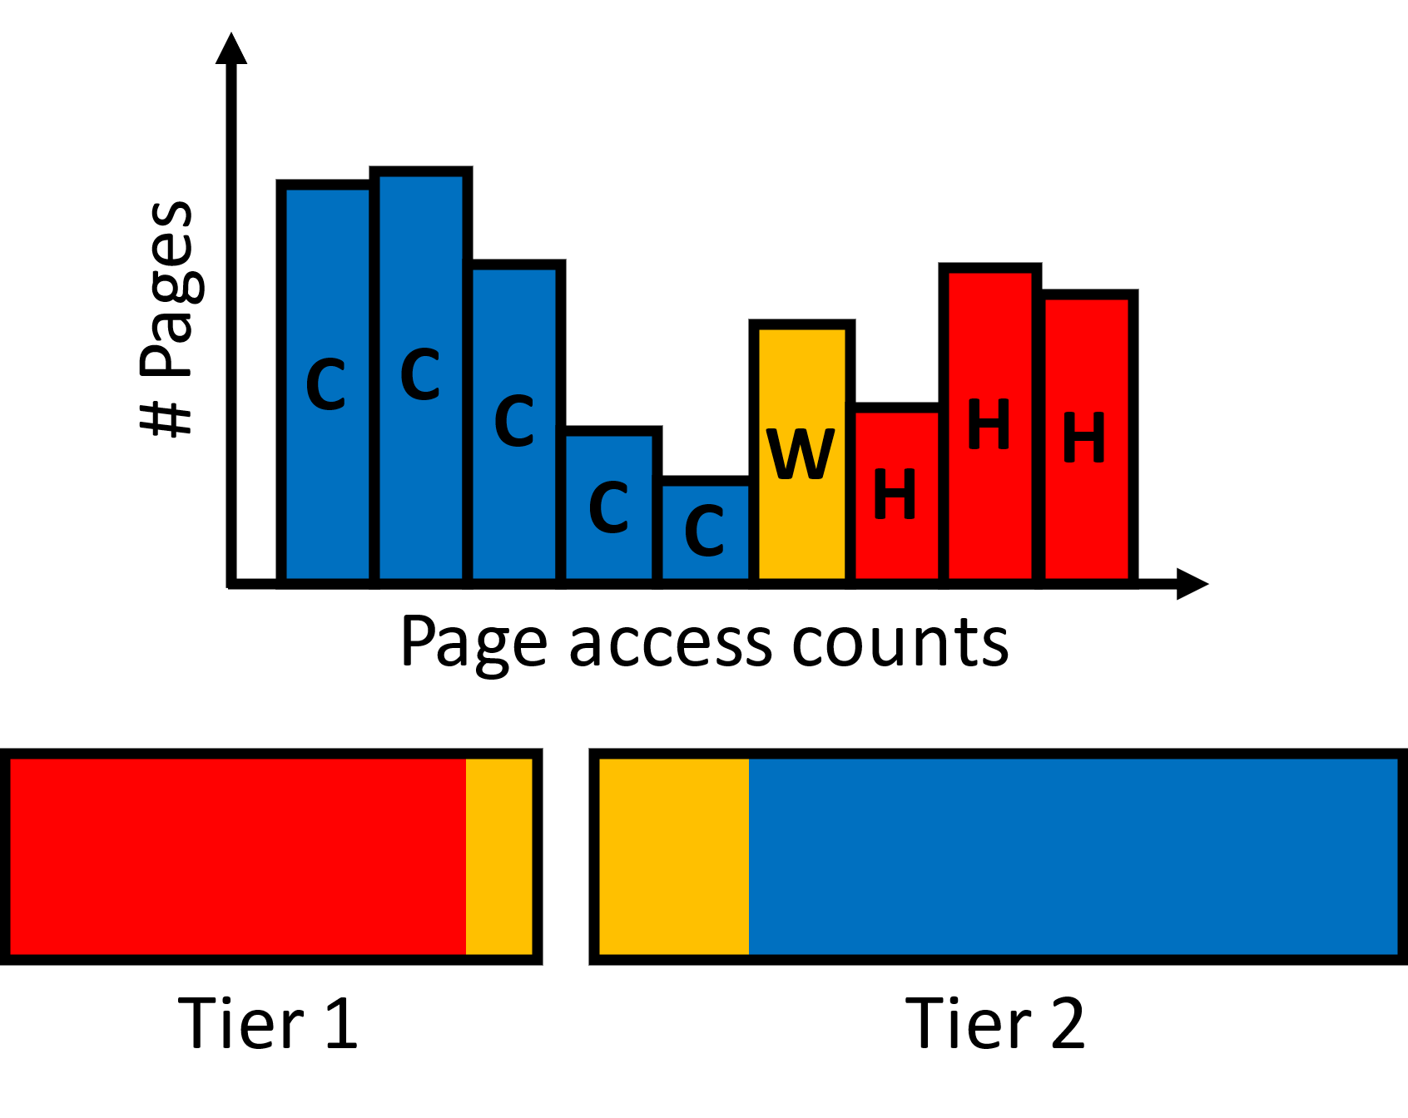

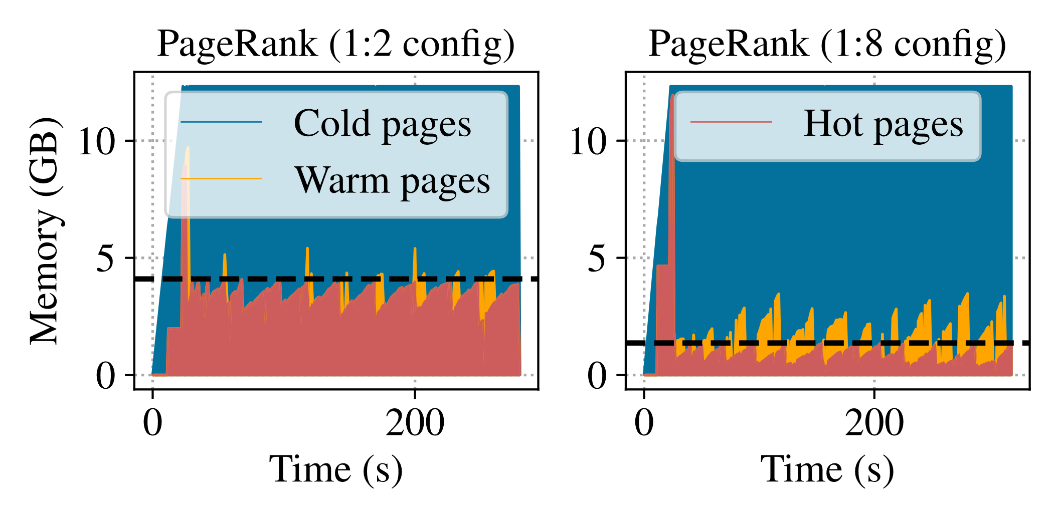
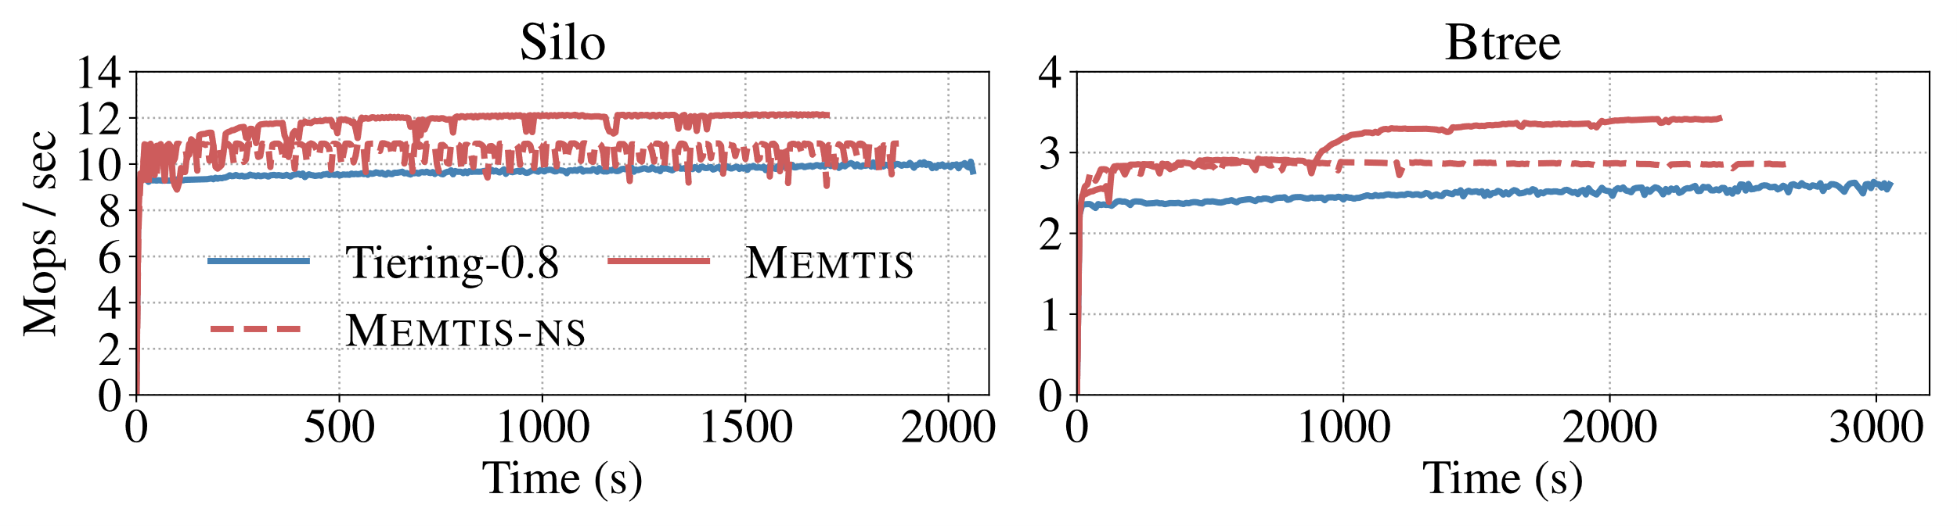
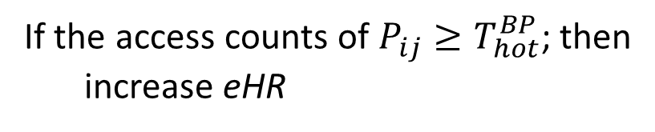
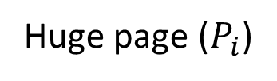
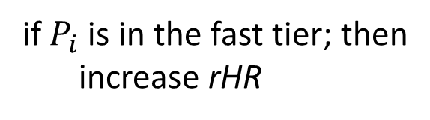
Memtis: Efficient Memory Tiering with Dynamic
Page Classification and Page Size Determination
Taehyung Lee¹, Sumit Kumar Monga², Changwoo Min³, and Young Ik Eom¹
¹Sungkyunkwan University, ²Virginia Tech, ³Igalia
1. Three insights from our observations
Page table scanning
Poor scalability to increasing memory sizes & num. of processes
Minimum tracking granularity: Page size (4KB, 2MB, 1GB in x86)
Tracking accuracy is also limited
HW event-based sampling
Scalable but overhead increases as sampling periods get shorter
Criticality of hotness detection
Existing systems adopt static approach
AutoNUMA: 1 accesses
TPP [ASPLOS ’23]: 2 accesses
Static criteria is insufficient to support diverse applications and memory config.
(E.g.) HeMem uses two static thresholds
Hot: 8(4) load(store) accesses
Cooling: 18 accesses
Is using huge pages always good?
Mitigate address translation costs
But could hamper the effective use of the fast tier memory
Skewed accesses are often observed
Frequently accessed but underutilized huge pages are problematic
Memory access heap map of 654.roms by DAMON (scan interval – min num. of regions – max num. of regions)
Liblinear
Silo (YCSB-C)
5ms-10-1000
500ms-10K-20K
5ms-10K-20K
NVM/CXL
DRAM
CPU usage: 2.15%
CPU usage: 3.18%
CPU usage: 72.85%
Insight #1) Memory access tracking
should be fine-grained, scalable, and lightweight
Insight #2) Need to adapt hotness
criteria given the system environments
Insight #3) Need to dynamically decide the appropriate page size
2. Memtis overview
3. Fine-grained, lightweight access tracking
Intel PEBS (Processor Event-Based Sampling)
LLC load miss (initial period: 1 sample / 200 events)
Store instruction (initial period: 1 sample / 100,000 events)
Adjusts the access period to meet the upper limit of its CPU usage (3% of a core)
Our sampling thread only consumes 2.016% of a single CPU with 0.922% of performance overheads on average
Generates two histograms
Page access histogram: used to determine hot pages; counting at actual page size
Emulated base page histogram: used to decide page sizes; counting at 4KB granularity
4. Histogram-based hot set classification
Periodically adapts the thresholds of hot/warm/cold pages
Expand the hot threshold as much as possible to hold the hottest pages in higher bins before overflowing the fast tier
Cooling: halves every page’s access count (→ calculating EMA of access counts)
5. Skewness-aware page size determination
Calculates eHR which is the estimated hit ratio when exclusively using base pages
Compares eHR to rHR (the real hit ratio obtained from PEBS)
If eHR > rHR + ⍺ → splintering huge pages will improve the fast tier hit ratio
Huge page ($P_{i}$)
if $P_{i}$ is in the fast tier; then
increase rHR
PMU
Event sampling
If the access counts of $P_{ij}≥T_{hot}^{BP}$; then
increase eHR
6. Evaluation results
Impact of huge page split
Memtis-ns: Memtis with no huge page split
Huge page split improves the overall perf. By 10.6% for Silo and 10.4% for Btree
Source code is available at https://github.com/cosmoss-jigu/memtis
Page hotness identification
The identified hot set size is very close to the fast tier
Other benchmarks show similar results
Normalized performance over the all-capacity tier case
Three memory configurations (fast tier : capacity tier) → 1:2 1:8, 1:16
Memtis always outperforms other systems

